Slide 1
Process mapping and flowcharting
Реферат по КНЕА
От Илиян Лазаров Игнатов ф.н.101207109 43гр.
Ту-София 2010

Slide 2
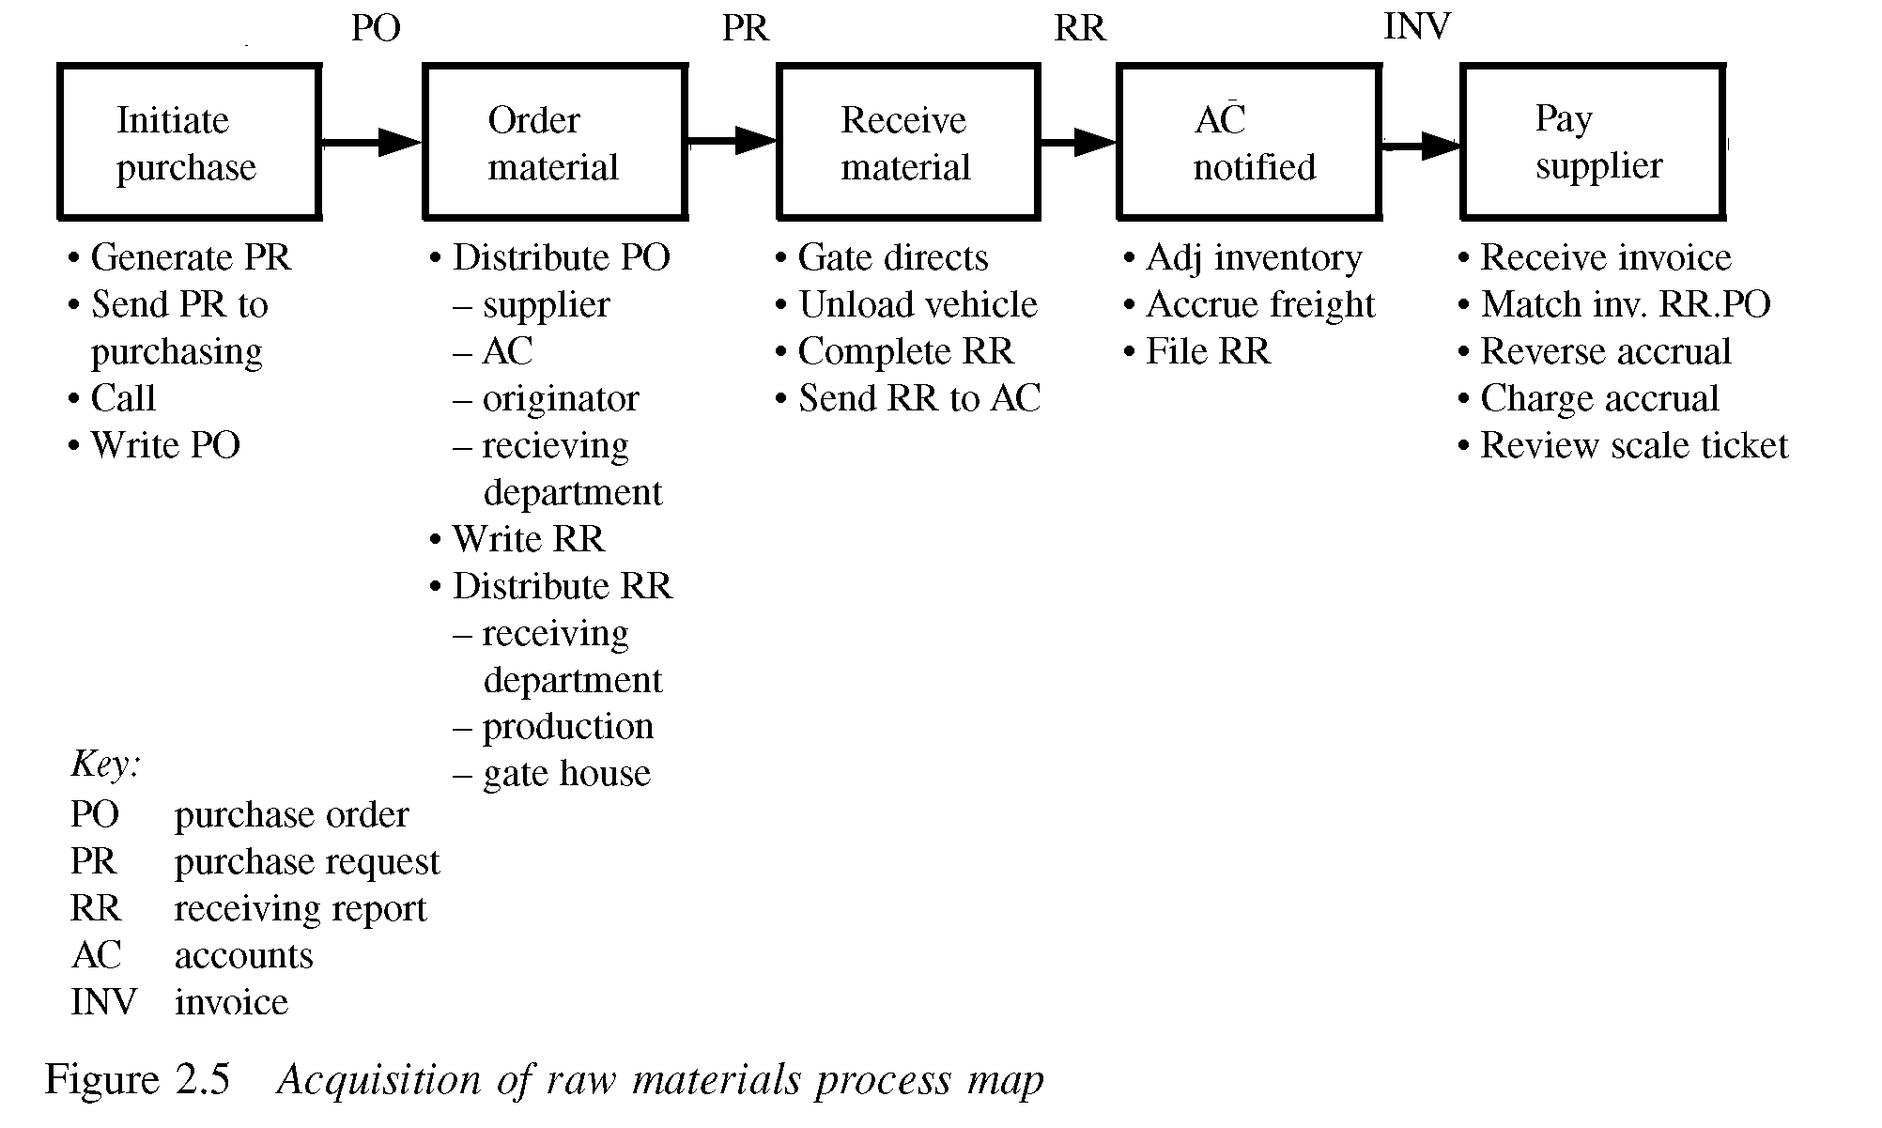
Process mapping and flowcharting
Process map

Slide 3
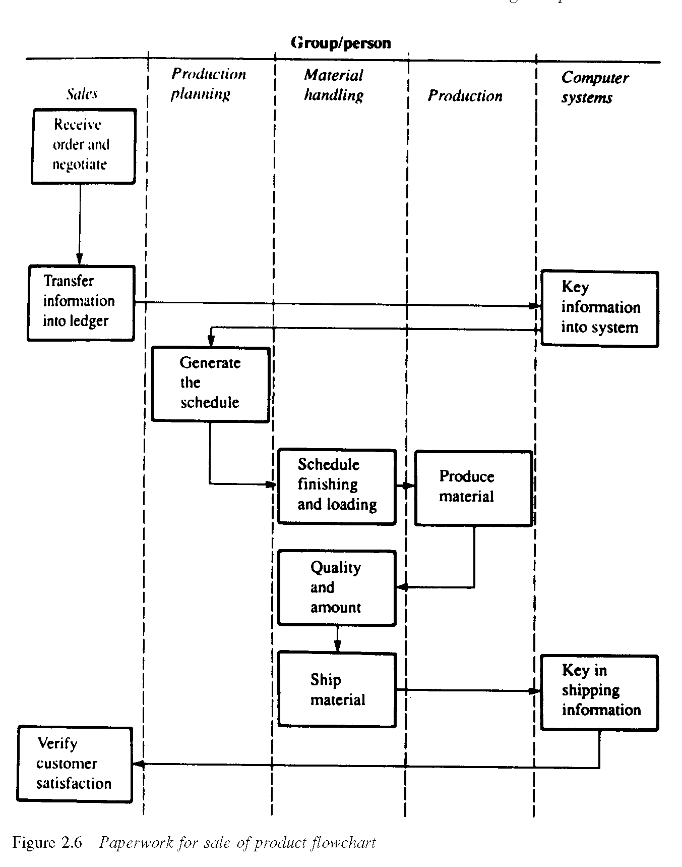
Process mapping and flowcharting
Process diagram

Slide 4
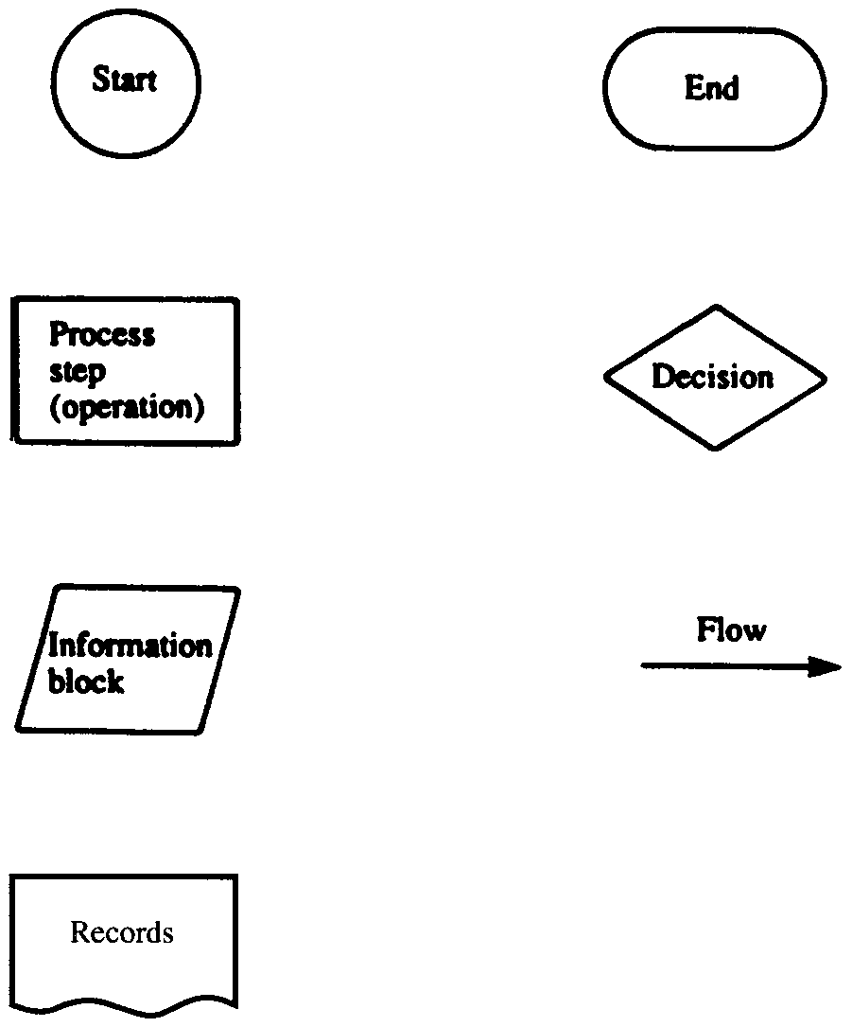
Process mapping and flowcharting
Classic flowchart symbols

Slide 5
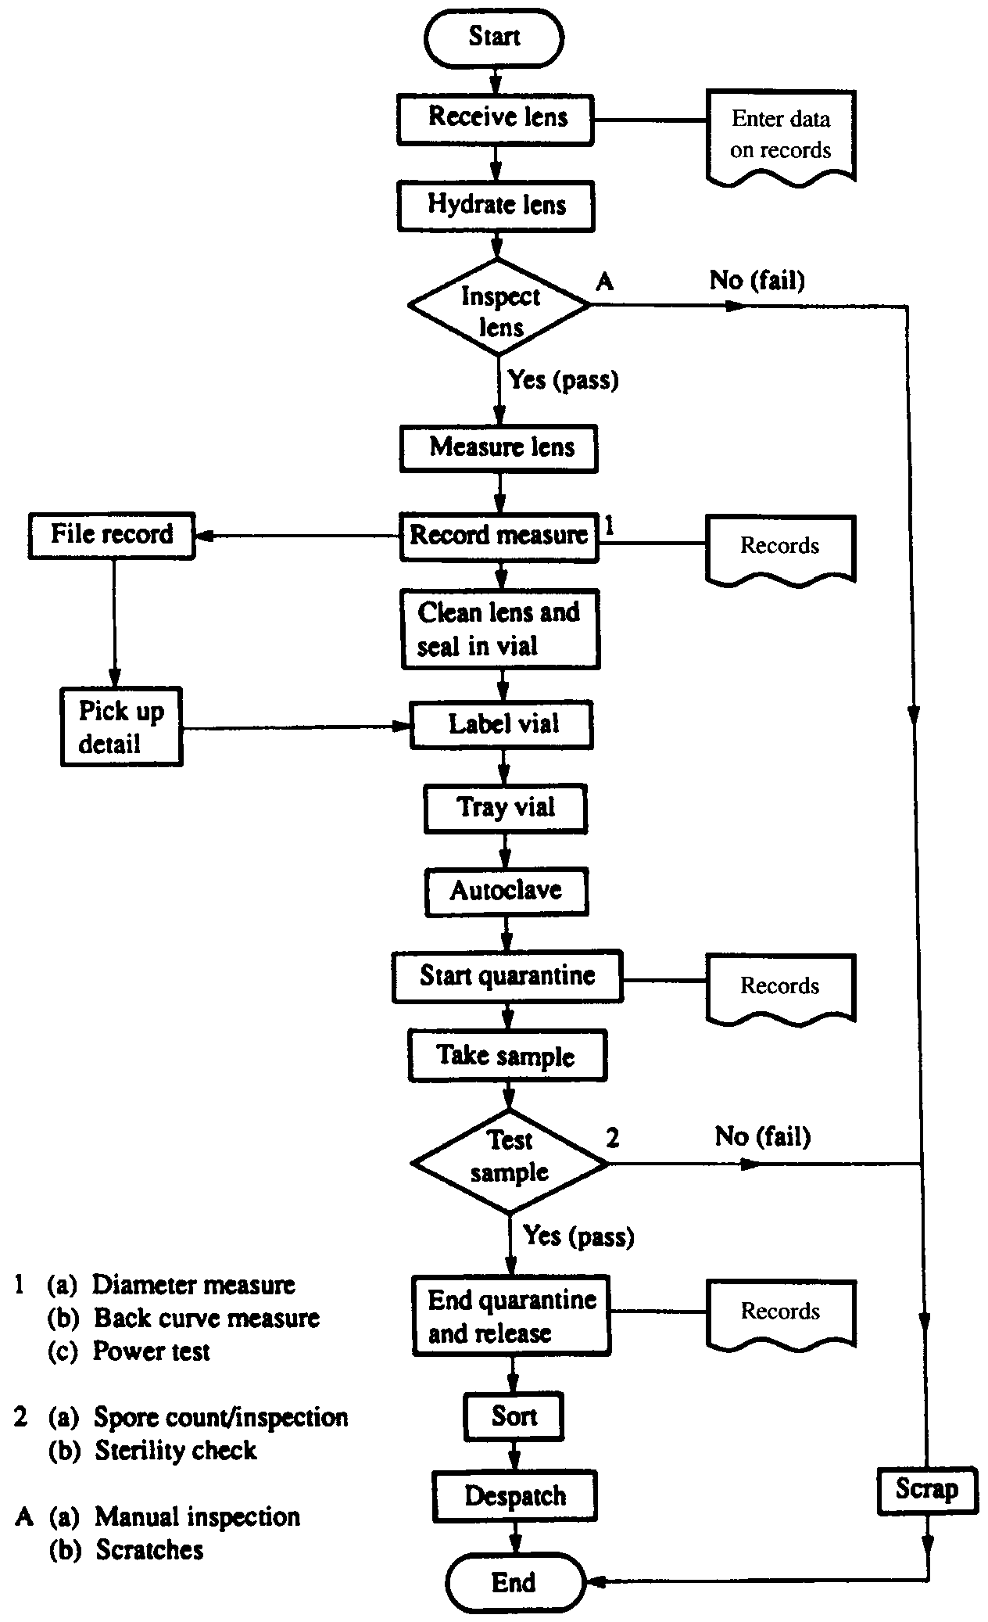
Process mapping and flowcharting
Classic flowchart

